Slide 1
Excello: Music Composition in Excel
Henry Mattinson – Final Dissertation Project
Computer Lab / Microsoft Research

Slide 2

Who’s Henry
2
Final Year Computer Science Student
Musician
Spreadsheet Enthusiast

Slide 3
Who’s Henry
3
Final Year Computer Science Student
Musician
Spreadsheet Enthusiast

Slide 4
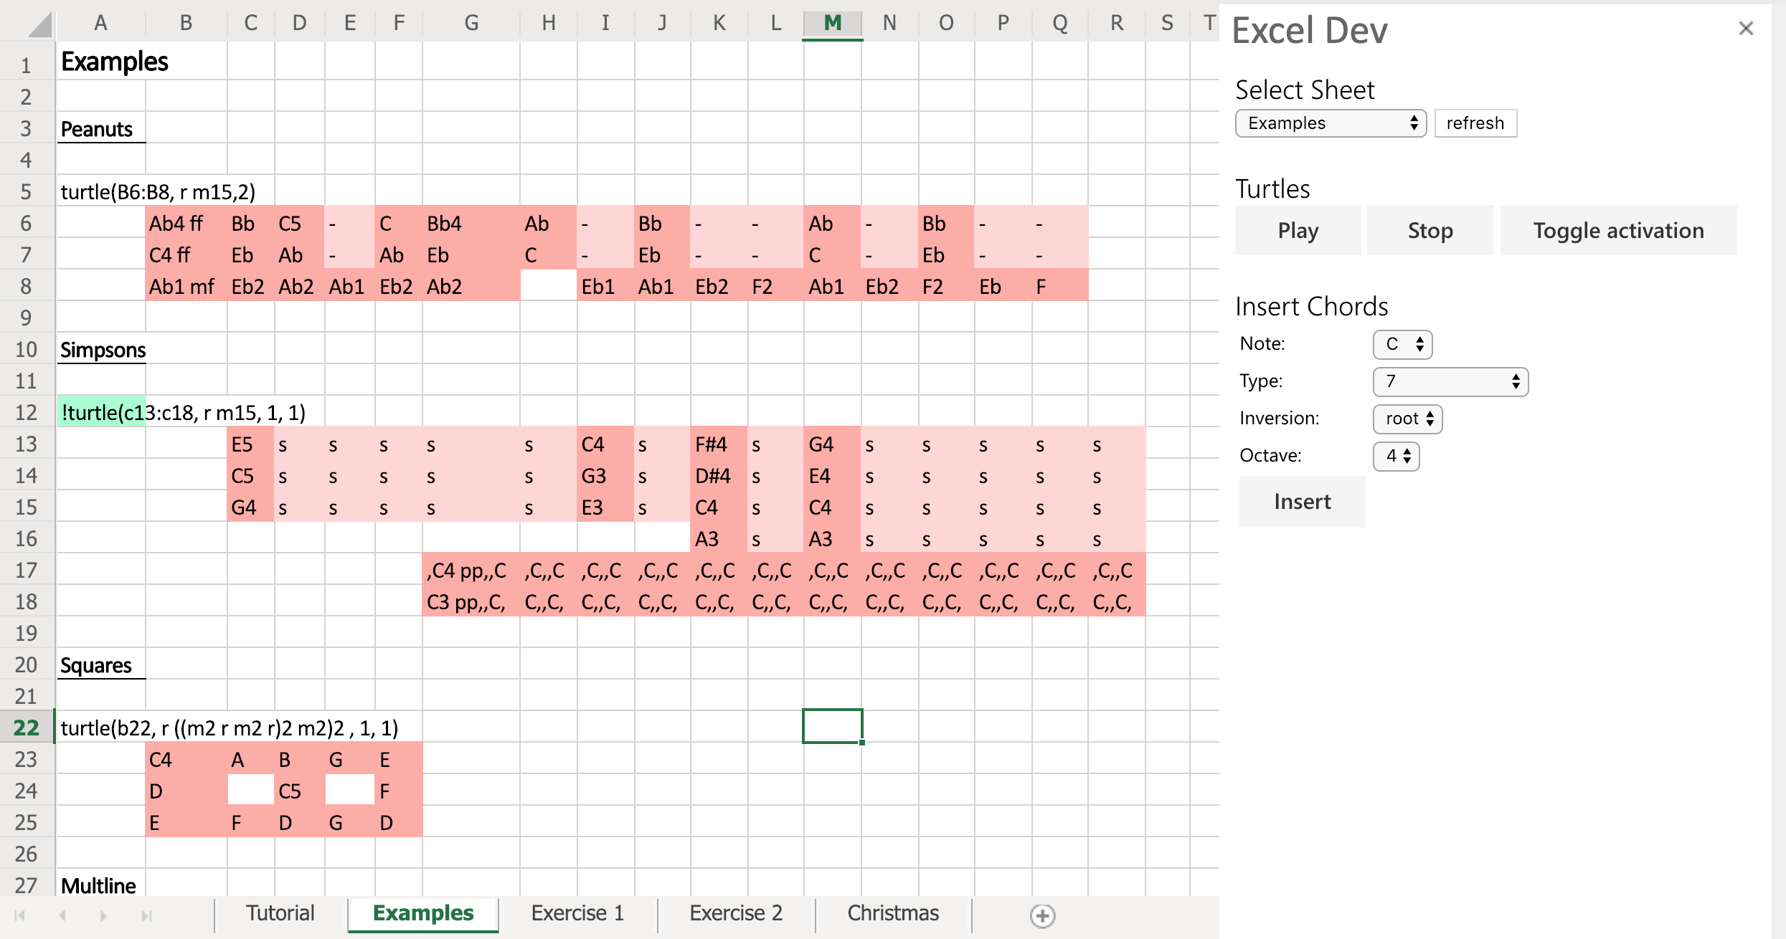
Design / Implementation
APIs
Tone.js
Excel
Turtles
Cells
Notes
Pitch
(Octave)
(Dynamics)
Rests
Sustains
Subdivided

Slide 5
Turtle Movements
turtle(<starting cell(s)>, <movements>, <speed>, <loops>)
Starting cell(s): “A1”, “A1:A5”
Movements
Direction changes
Relative direction changes: “r”, “l”
Absolute direction changes: “n”, “e”, “s”, “w”
Movements
Step forwards: “m4”
Absolute jumps: “jA1”
Relative jumps: “j-7+1”
Nesting: “(…)n”
E.g. “(r m3)4” = “r m3 r m3 r m3 r m3”
Speed: “1”, “1+1/3”
Loops: number of times the path is looped

Slide 6
Cooperative Evaluation
Participants
20 +
Cambridge University students
Wide range of musical / technical experience
Evaluation sessions
Tutorial
Exercise
Improvements / suggestions
Summative evaluation
CDN profiles

Slide 7
Other Features
Piano Samples
Chord inputs
Octave context
Activation

Slide 8
Next Steps
Features
Infer movement length “r m*”
Live?
MIDI converter
MIDI -> Excel notation (evaluation)
Excel notation -> MIDI?
Summative evaluation

